Slide 1
Ensemble Learning

Slide 3
Ensemble Approaches
Bagging
Bootstrap aggregating
Boosting
Random Forests
Bagging reborn

Slide 4
Bagging
Main Assumption:
Combining many unstable predictors to produce a ensemble (stable) predictor.
Unstable Predictor: small changes in training data produce large changes in the model.
e.g. Neural Nets, trees
Stable: SVM (sometimes), Nearest Neighbor.
Hypothesis Space
Variable size (nonparametric):
Can model any function if you use an appropriate predictor (e.g. trees)

Slide 5
The Bagging Algorithm
Given data:
For
Obtain bootstrap sample from the training data
Build a model from bootstrap data

Slide 6
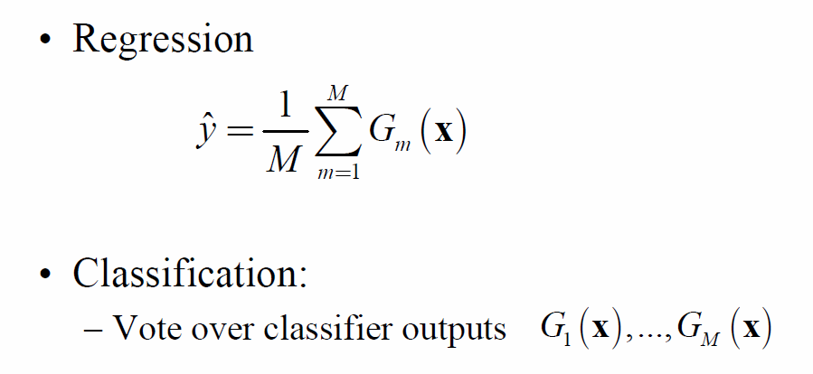
The Bagging Model
Regression
Classification:
Vote over classifier outputs

Slide 7
Bagging Details
Bootstrap sample of N instances is obtained by drawing N examples at random, with replacement.
On average each bootstrap sample has 63% of instances
Encourages predictors to have uncorrelated errors
This is why it works

Slide 8
Boosting
Main Assumption:
Combining many weak predictors (e.g. tree stumps or 1-R predictors) to produce an ensemble predictor
The weak predictors or classifiers need to be stable
Hypothesis Space
Variable size (nonparametric):
Can model any function if you use an appropriate predictor (e.g. trees)

Slide 9
Stacking
Stacking, also known as stacked generalization or model stacking, is an ensemble machine learning technique that combines multiple base models (classifiers or regressors) to improve predictive performance.
It aims to leverage the strengths of different models by training a meta-model that learns how to best combine the predictions of these base models.

Slide 10
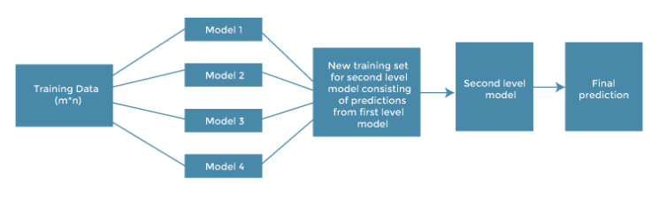

Slide 11
Original data: This data is divided into n-folds and is also considered test data or training data.
Base models: These models are also referred to as level-0 models. These models use training data and provide compiled predictions (level-0) as an output.
Level-0 Predictions: Each base model is triggered on some training data and provides different predictions, which are known as level-0 predictions.

Slide 12
Meta Model: The architecture of the stacking model consists of one meta-model, which helps to best combine the predictions of the base models. The meta-model is also known as the level-1 model.
Level-1 Prediction: The meta-model learns how to best combine the predictions of the base models and is trained on different predictions made by individual base models, i.e., data not used to train the base models are fed to the meta-model, predictions are made, and these predictions, along with the expected outputs, provide the input and output pairs of the training dataset used to fit the meta-model.

Slide 13
How stacking works?
# Import necessary libraries
# Load the Iris dataset as an example

Slide 14
Bagging, boosting, and stacking Impact on Bias and Variance
Bagging, boosting, and stacking are ensemble learning techniques used to improve the performance of machine learning models. Each of these techniques has a different approach to combining multiple base models and has a distinct impact on bias and variance.

Slide 15
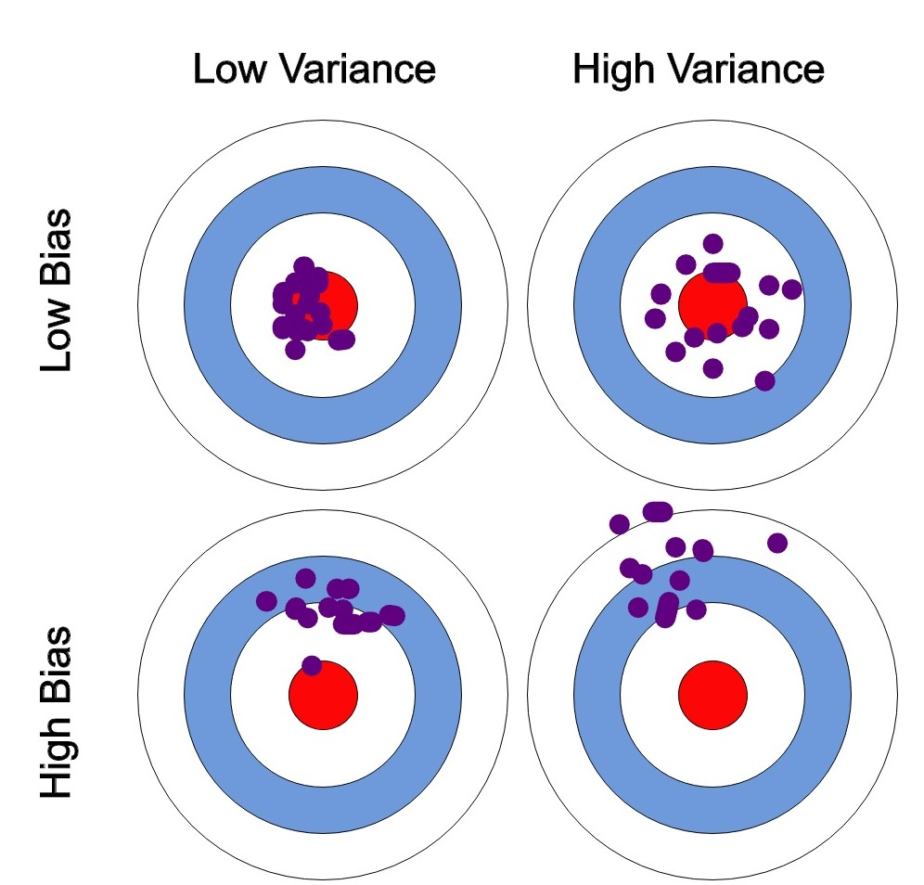
Impact on Bias and Variance:

Slide 16
Bagging (Bootstrap Aggregating):
Method: Bagging creates multiple base models by training each one on a randomly sampled subset of the training data (with replacement) and then combines their predictions, often by averaging (for regression) or voting (for classification).

Slide 17
Bagging-Impact on Bias and Variance:
Impact on Bias and Variance:
Variance Reduction: Bagging helps reduce the variance of the model. By training multiple models on different subsets of the data, it introduces diversity in the models. When their predictions are combined, errors in individual models tend to cancel out, resulting in a more stable and less overfit model.
Minimal Impact on Bias: Bagging doesn't significantly affect the bias of the base model. The average prediction is still centered around the true values, and the bias remains similar to that of the base model.

Slide 18
Boosting:
Boosting:
Method: Boosting builds a sequence of base models in an adaptive manner. Each new model is trained to correct the errors made by the previous ones. The final prediction is a weighted sum of all the models' predictions.

Slide 19
Boosting:
Impact on Bias and Variance:
Bias Reduction: Boosting tends to reduce bias. By repeatedly focusing on examples that the previous models got wrong, boosting adapts and tries to fit the training data better.
May Increase Variance: Boosting can increase the variance of the model. Since the models are built sequentially and may become increasingly complex, they can overfit to the training data. Regularization techniques are often used to mitigate this.

Slide 20
Stacking:
Method: Stacking combines the predictions of multiple base models by training a meta-model on their outputs. The base models' predictions serve as the input features for the meta-model.

Slide 21
Stacking:
Impact on Bias and Variance:
Bias and Variance Trade-Off: Stacking can potentially reduce both bias and variance, but it's highly dependent on the choice of base models and the meta-model. By using diverse base models, you can obtain predictions with lower bias and variance. The meta-model can then fine-tune these predictions.
Overfitting Potential: Stacking can be prone to overfitting if not properly tuned. The meta-model's complexity and the risk of overfitting depend on the diversity and quality of the base models.

